Slide 1

Microservices Architecture
Microservices
Microservices
Microservices
Microservices
Microservices
Microservices
Monolithic

Slide 2
Monolith Applications

Slide 3
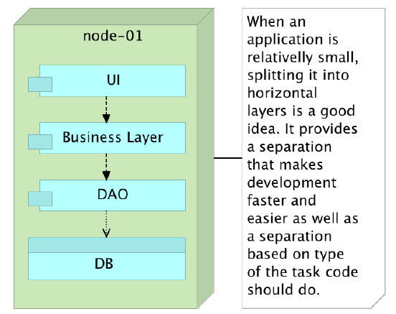
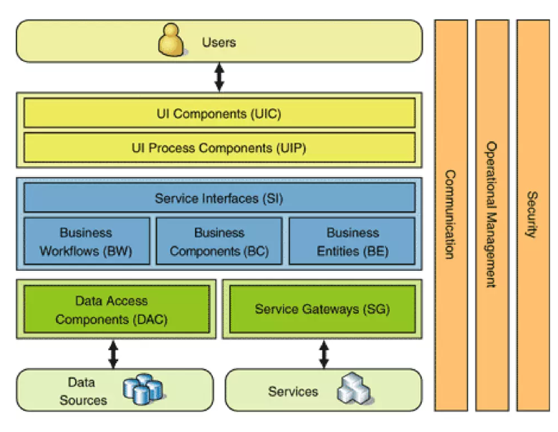
Monolithic Applications

Slide 4
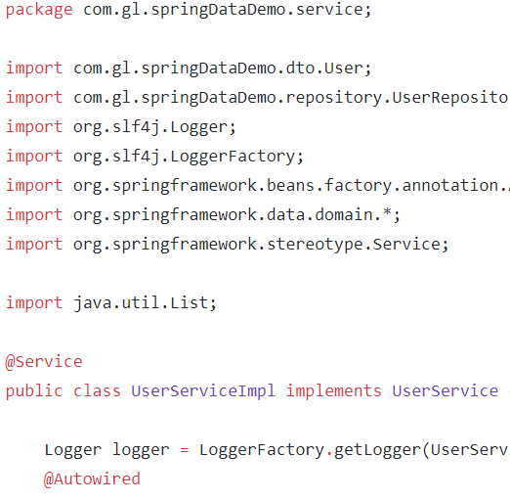

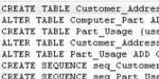
Online Shopping Portal
C
O
N
T
R
O
L
E
R
L
A
Y
E
R
D
A
O
L
A
Y
E
R
Product Management
Database
Account Management
Payment Management
Login Management
Order Management

Slide 5
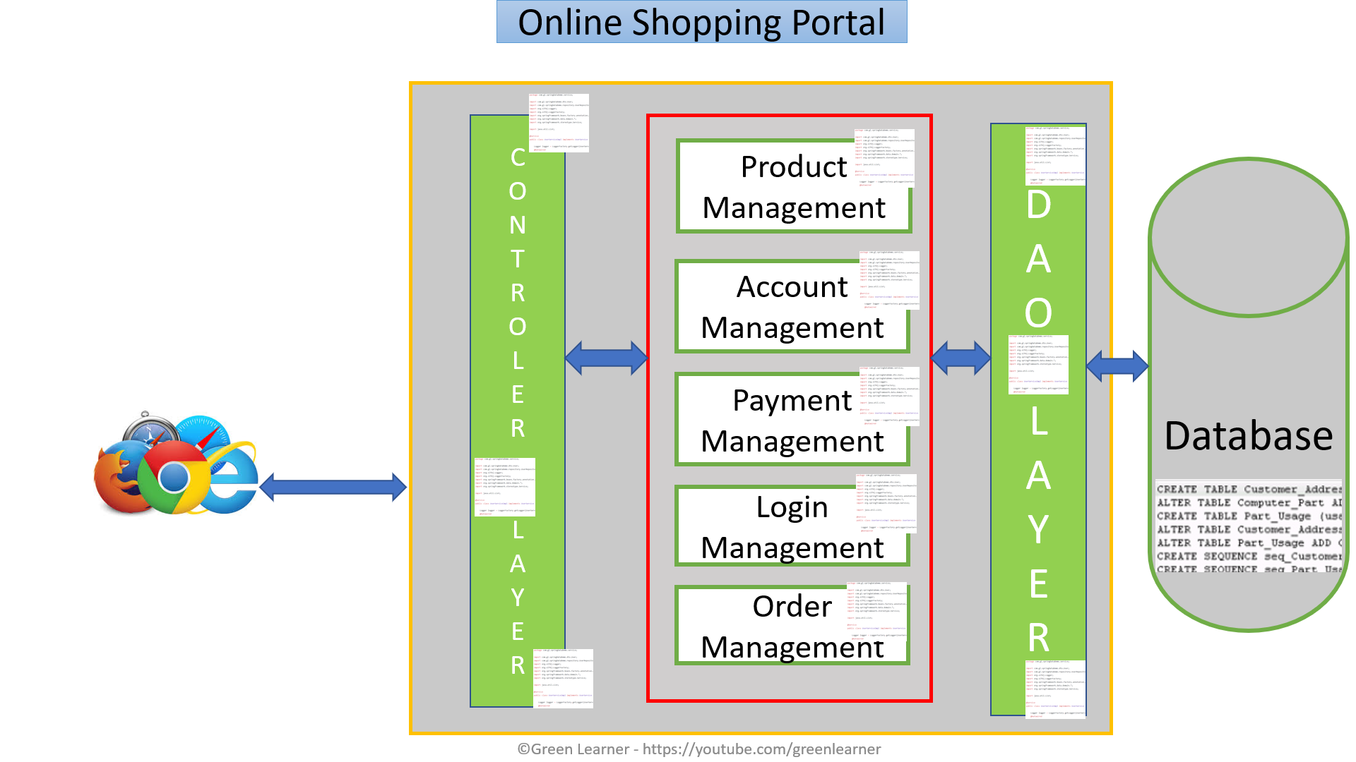
Monolith – positive aspects
Simple testing
Quick deployment
Easy to develop

Slide 6
Monolith – positive aspects
Easy to scale by having multiple copy of same application(horizontal scaling)
Less technicality
Better for small scale apps

Slide 7
By the time company grows
so the application

Slide 8


Online Shopping Portal
C
O
N
T
R
O
L
E
R
L
A
Y
E
R
D
A
O
L
A
Y
E
R
Product Management
Database
Account Management
Payment Management
Login Management
Order Management

Slide 9
Monolith – Challenges
Limitation in size
Complexity grows with time
Long time to release new features
Even small change in one module needs redeployment of whole application
More time to send the fix for production bug

Slide 10
Monolith – Challenges
High Dependency on few human resources
Hiring new team and making them understand whole application is tough
Stuck in one technology
Single point failure

Slide 11
Monolith – Challenges
Continuous deployment is difficult
Difficult to scale when we have large code base
High coupling between modules
Reliability and availability problem

Slide 12
What’s the solution then??

Slide 13
Microservices

Slide 14
Online Shopping Portal
Database
G
A
T
E
W
A
Y
Product Management
Database
Order Management
Database
Account Management
Database
Payment Management
Login Management
Database

Slide 15
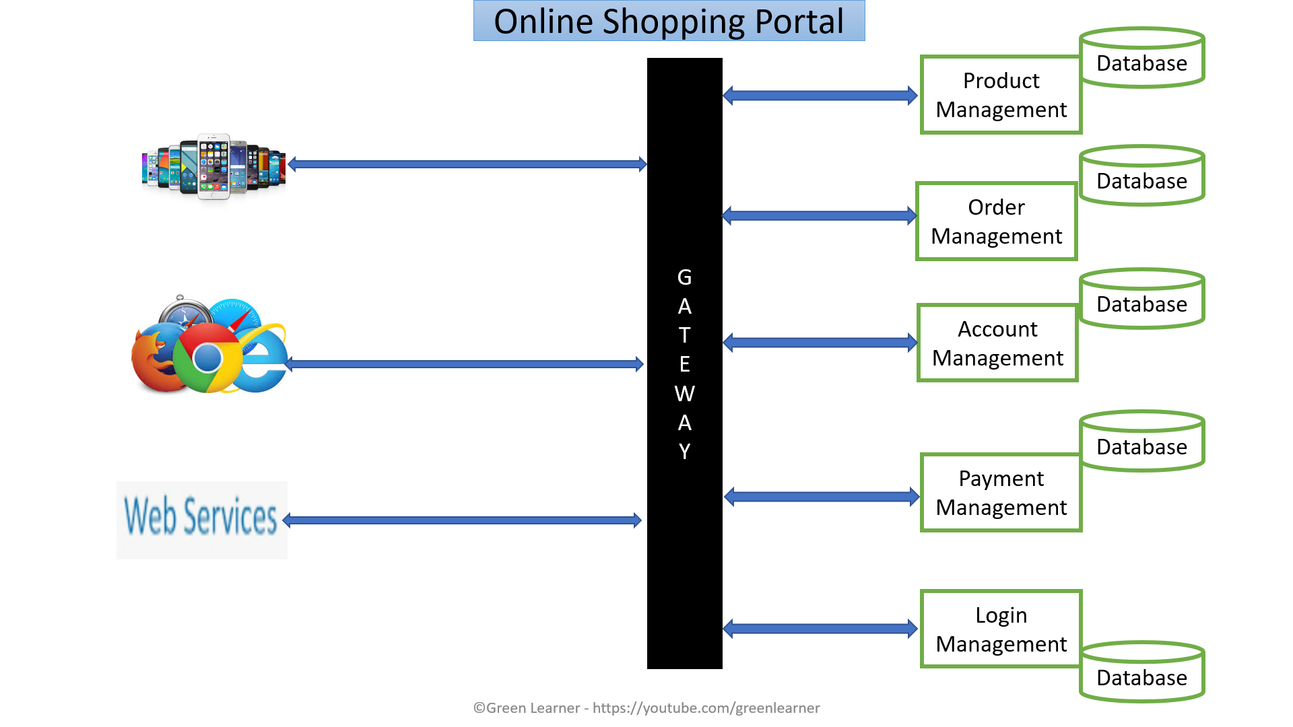
Microservices : Positive aspects
Domain expertise
Easy and quick to scale – on demand
Isolated decision making
Self Organisation
Quick response to change
Increase uptime
Can experiment with any tech
Loose coupling
Service reusability
Agile, SCRUM
Best for large scale apps

Slide 16
Microservices :Challenges
Additional complexity with distributed systems
Deployment complexity
Monitoring complexity
Increased resource consumption
Communication among services is challenging
Testing each service is also a challenge
Maintaining transnationality among services

Slide 17
Fundamental problems with Monoliths which can’t be solved without changing the architecture??
Response to change – bug fix or adding new feature
On demand scaling
Flexibility
Adopting new technologies for better performance

Slide 18
Microservices Architecture
Microservices: design principles

Slide 19



Why?? Is it mandatory to go through these?

Slide 20
What are Design Principles??
Independent/ Autonomous
Resilient/ Fault Tolerant/ Design For Failure
Observable
Discoverable
Domain Driven
High Cohesion
Single Source Of Truth
Decentralization

Slide 21
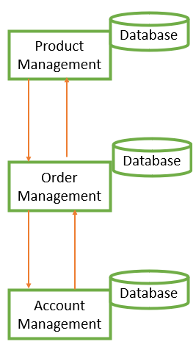
Small team size
Parallel development
Clear contracts
Individually deployable
Independent/ Autonomous

Slide 22
Avoid single point of failure
Avoid cascading failure
Consider failure as events and analyse it properly
Resilient /
Fault Tolerant / Design For Failure

Slide 23
Centralized monitoring
Centralized logging
Health check system
Observable

Slide 24
All services should be registered at one place
It makes client’s life easy when looking for specific service
Discoverable

Slide 25
Focussed on business
Focussed on core domain
Focus on Domain logic
Domain Driven

Slide 26
Database for each service
Choice of database depends on the nature of particular service
Decentralization

Slide 27
Do one thing only
SRP
A business function
A business domain
Easy to take new similar feature
Why
Scalability
Availability
Database
Product Management
High Cohesion
Database
Order Management
Database
Account Management

Slide 28
There should be only one source to get the complete information
This helps in avoiding the duplicity
Single Source Of Truth

Slide 29
Microservices Architecture
Microservices: Design Patterns

Slide 30
Why??
We need our services to be highly
Available
Scalable
Resilient to failures
Efficient
Design patterns help in solving the specific microservice architecture challenge
Design patterns help in reducing risk of failure in microservices

Slide 31
What are those patterns??
Decomposition
Database
Communication Among services
Integration
Observability
Cross-cutting concern
Deployment

Slide 32
Decomposition patterns
Database patterns
By business capabilities
By subdomain
Strangler pattern
Sidecar pattern / Service mesh
Database per service
Shared Database
CQRS
Event Sourcing

Slide 33
Communication Among services
Synchronous
Async - event/messag based
Communication Medium
HTTP REST - xml/json
Graphql
gRPC
Integration patterns
API gateway
Aggregator pattern
Chained Pattern
Branch pattern
client side UI composition patterns

Slide 34
Deployment patterns
Multiple service instances per host
Service instance per host
Service instance per VM
Service instance per Container
Server less
Blue green
Canary

Slide 35
Observability
Log aggregation
Performance metrics
Distributed tracing
health check
Cross Cutting Concern Patterns
external configuration
service discovery pattern
circuit breaker pattern

Slide 36
Microservices Architecture
Decomposition Pattern : By Business Domain & Sub Domain

Slide 37
There are 2 kinds of project under microservices
Monolithic to Microservices – Brown Field Projects
Microservices in nature from scratch – Green Field Projects

Slide 38




Microservice – Micro + Service
How Micro? How Small?

Slide 39
How to decide the size of microservice??
Business functionality

Slide 40
How to decide the size of microservice??
Order Management
Placing order
Order tracking
Invoice generation
God Classes
Shared among different modules
Sub domain
Domain Driven Design
Bounded context

Slide 41
Microservices Architecture
Decomposition Pattern : Strangler

Slide 42
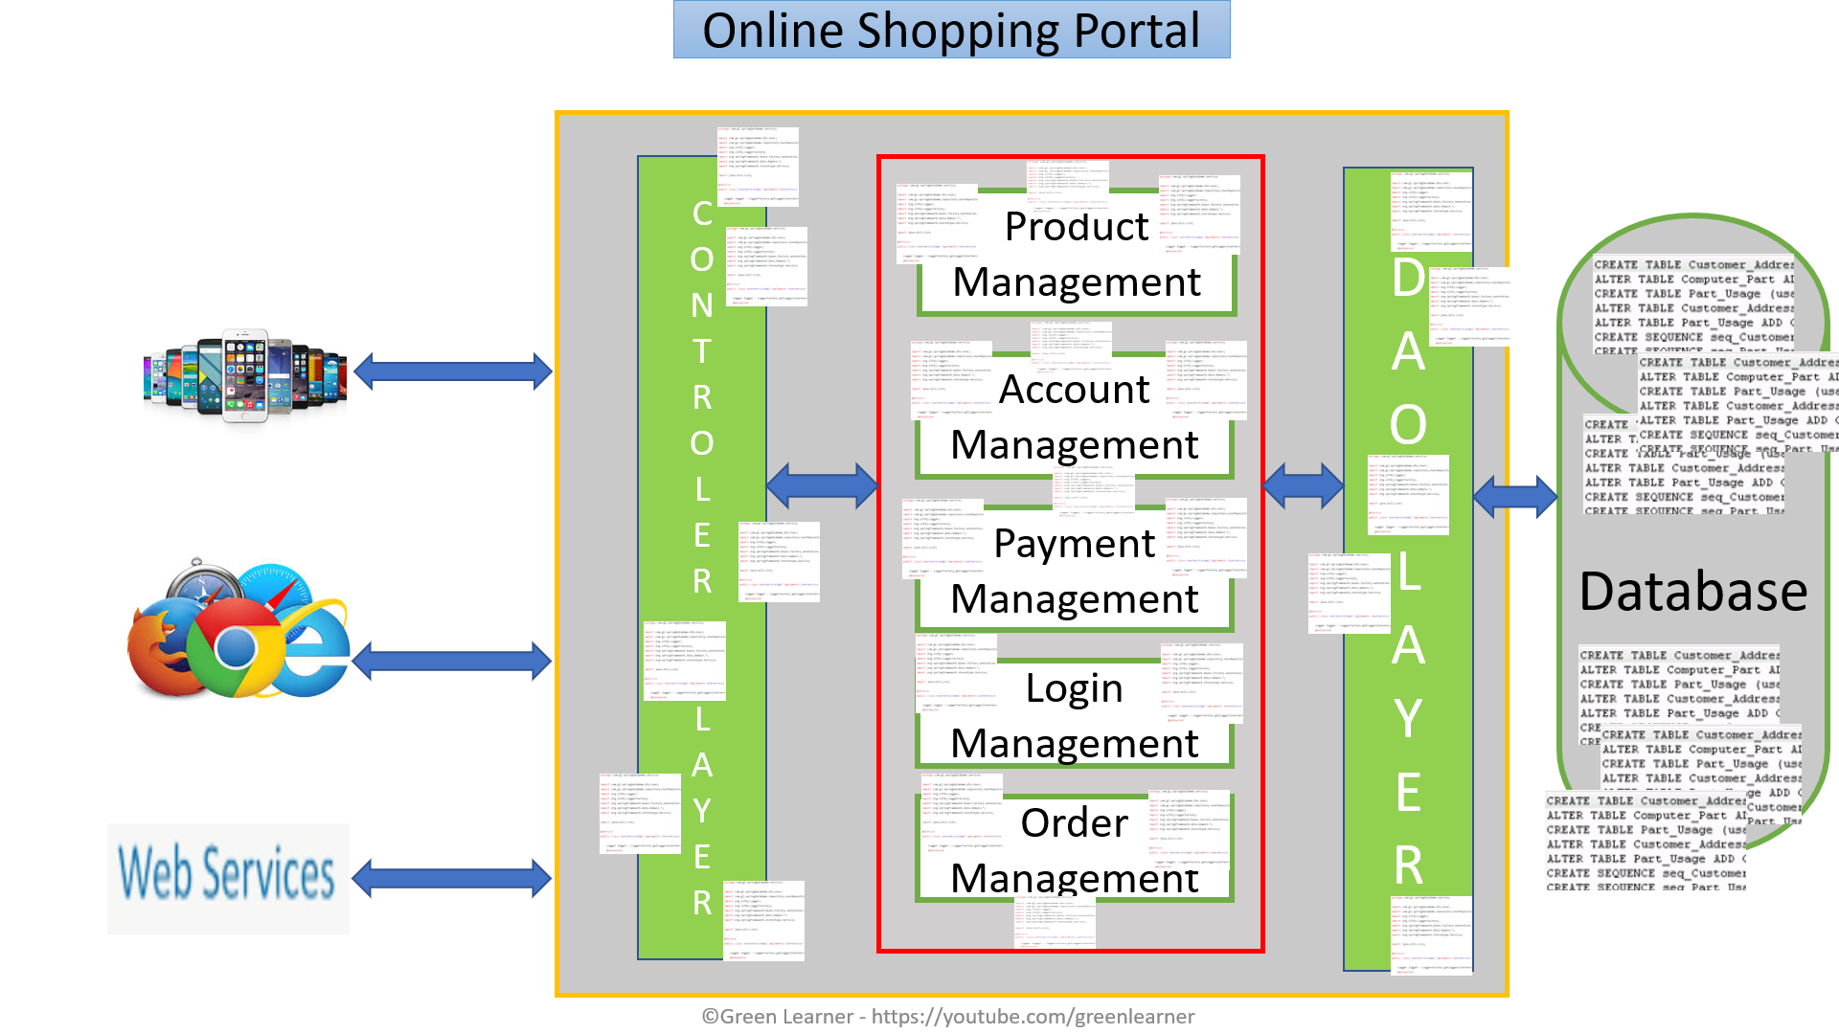
Use Case

Slide 43
Account Management
Product Management
Product Management
Account Management
Route
Product Management

Slide 44
Transform
Co-Exist
Eliminate

Slide 45

Strangler fig

Slide 46
Microservices Architecture
MICROSERVICES DESIGN PATTERNS
Decomposition Pattern : Sidecar/Sidekick Pattern

Slide 47
Common feature to take care for each service
Logging
Failure Isolation
Monitoring
Configuration
Proxy to remote service
etc..

Slide 48
Order Management
SIDECAR
Product Management
Account Management
SIDECAR
SIDECAR
Login Management
Payment Management
SIDECAR
SIDECAR

Slide 49
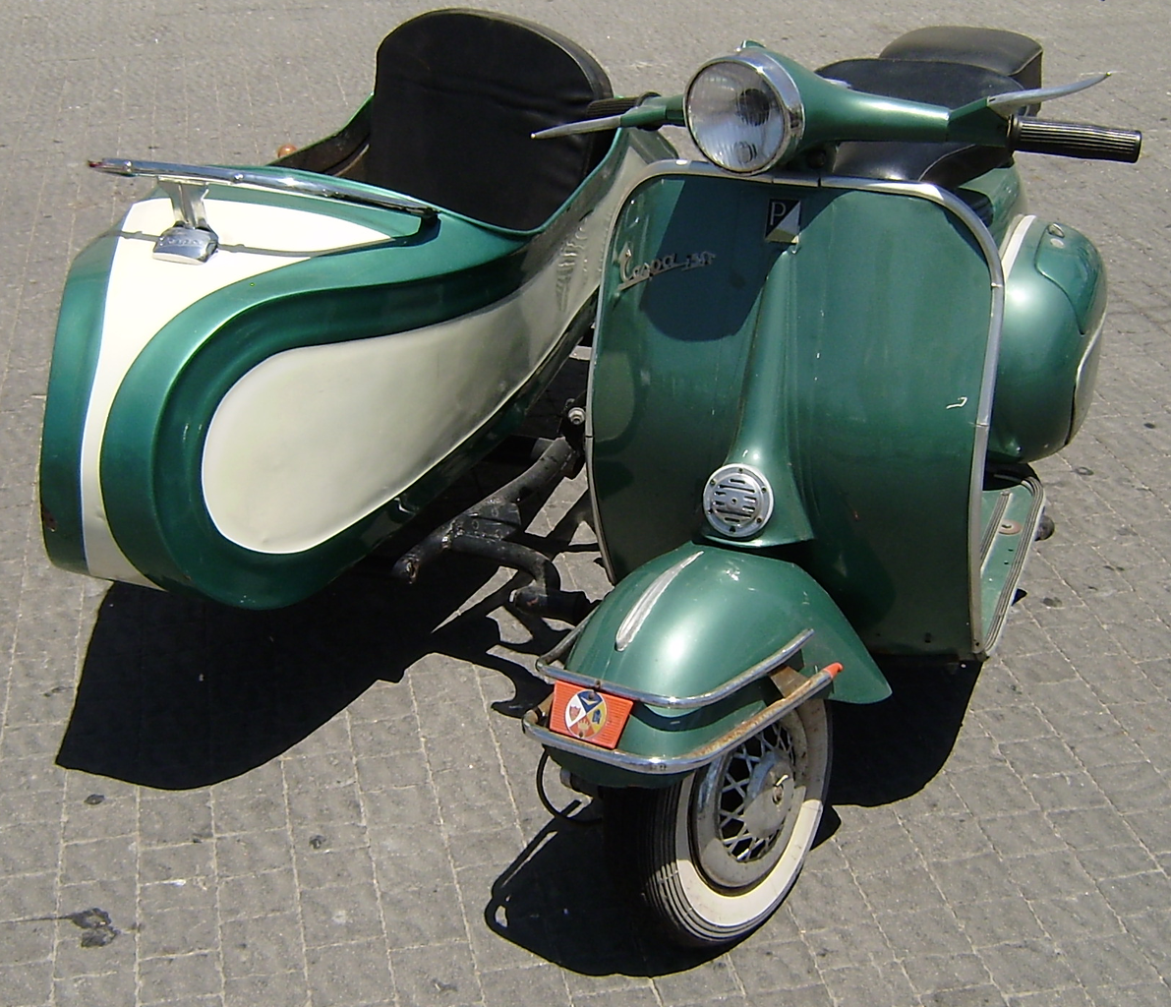
Sidecar

Slide 50
Advantages
Independent from primary application in terms of run time and the language in which they are implemented – loose coupling
Can access the same resource as primary application
Low latency due to proximity
Reduces the code duplication
Reduces the complexity in the main application

Slide 51
Issues & Concerns
Try to use language- or framework-agnostic technologies
Before putting functionality into a sidecar, consider whether it would work
better as a separate service or a more traditional daemon.
the functionality could be implemented as a library.
Containers are particularly well suited to the sidecar pattern.

Slide 52
What next??
Decomposition Pattern : Service-Mesh

Slide 53
Microservices Architecture
MICROSERVICES DESIGN PATTERNS
Decomposition Pattern : Service Mesh

Slide 54
Use Case (Problem Statement)
Communication Complexity
Failure Isolation
Service Discovery
Config changes
Order Management
Product Management
Account Management
Login Management
UI
Payment Management

Slide 55
What is service mesh?
It’s dedicated infrastructure layer for service-to-service communication
focusing on managing all service-to-service communication within a distributed software system.
This makes communication optimization easier
It’s a way to control how different parts of an application share the data among themselves
Typically array of network proxies
Deployed alongside main service
Main service need not to be aware of this proxy
For cloud native application

Slide 56
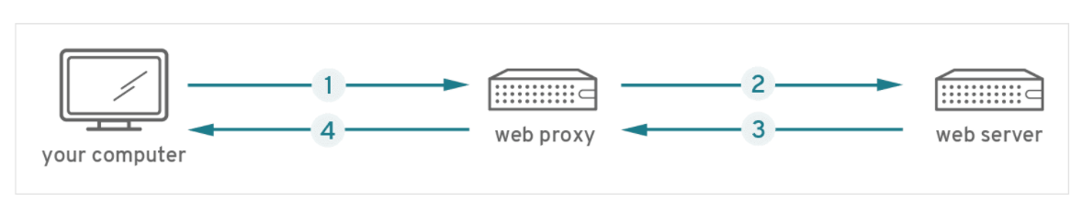
How does it work??
https://www.redhat.com/en/topics/microservices/what-is-a-service-mesh

Slide 57
Remember this one??
Order Management
SIDECAR
Product Management
Account Management
SIDECAR
SIDECAR
Login Management
Payment Management
SIDECAR
SIDECAR

Slide 58

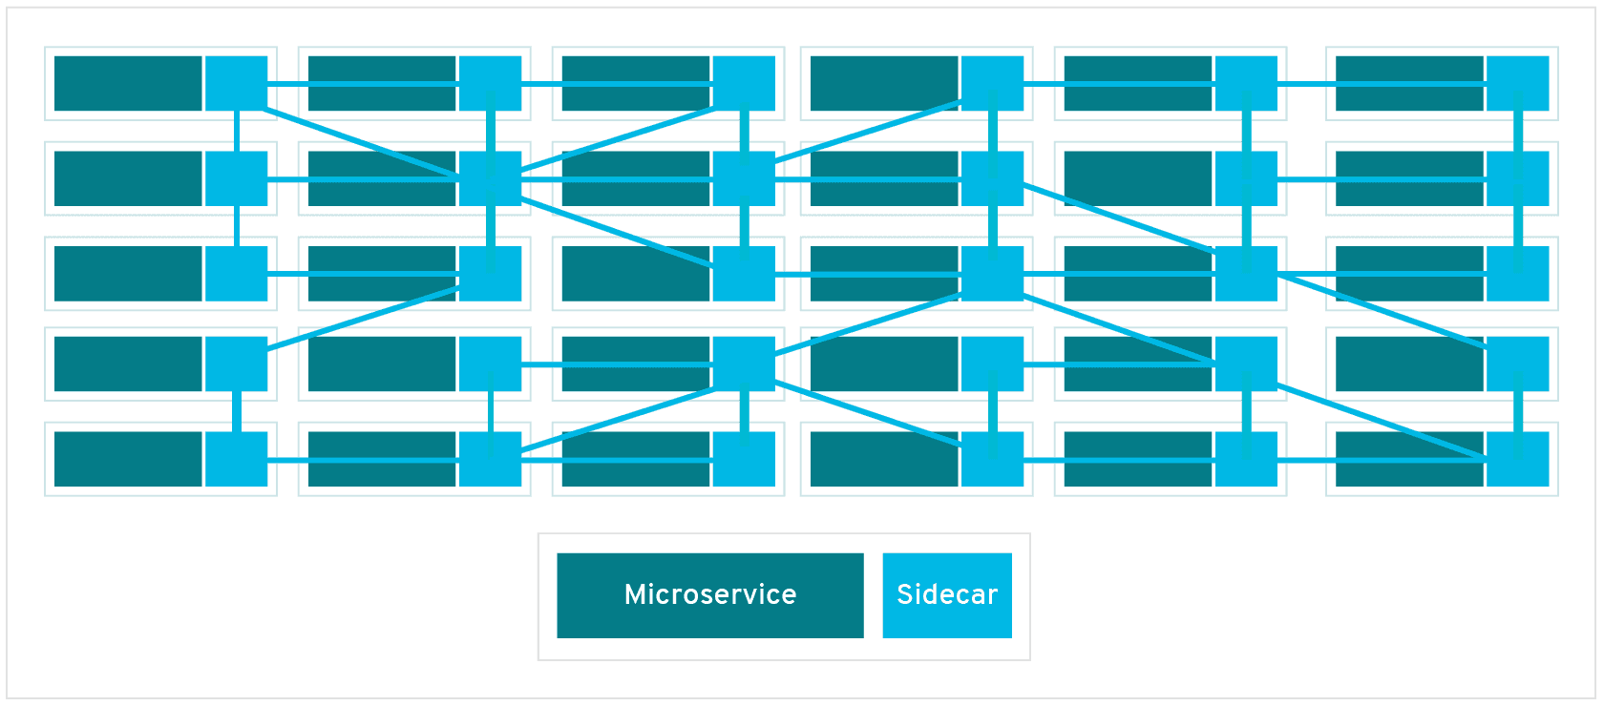
Now it’s like real Mesh

Slide 59
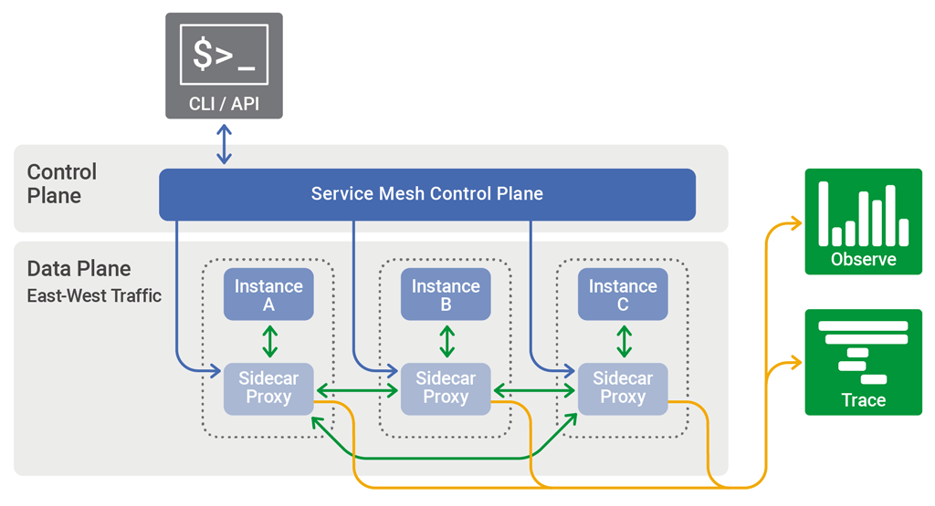
The control plane in a service mesh distributes configuration across the sidecar proxies in the data plane

Slide 60
Role of Service Mesh
Service Discovery
Fault Tolerance
Routing
Observability
Logging
Monitoring
Security
Access Control
Deployment

Slide 61
Pros & Cons
Pros
Centralized solution for logging, distributed tracing, logging security, access control
All of these are reusable for different microservices
Language agnostic for microservices
Cons
Complexity
Extra network hop
New and Immature
FAQ - https://www.infoq.com/articles/service-mesh-ultimate-guide/

Slide 62
How to Implement Service Mesh
https://linkerd.io/
https://istio.io/
https://www.envoyproxy.io/
https://www.consul.io/

Slide 63
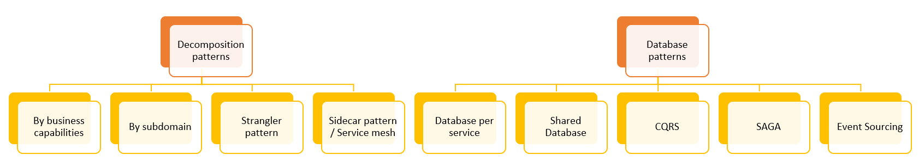
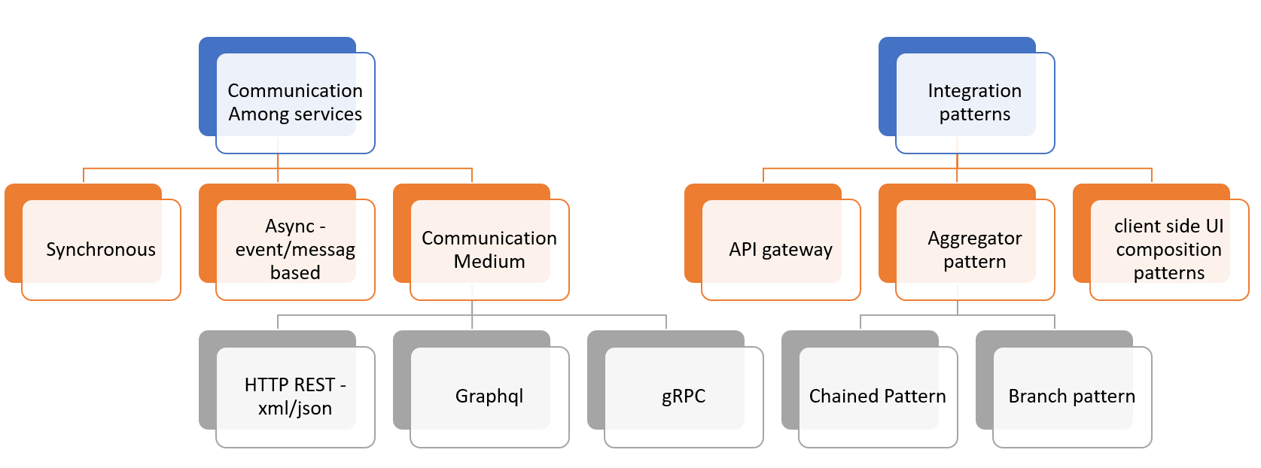
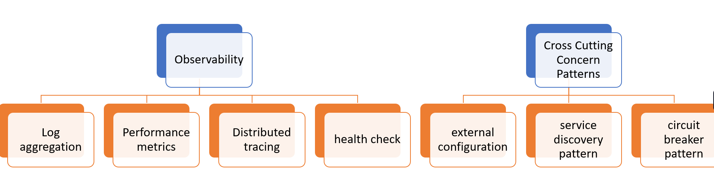
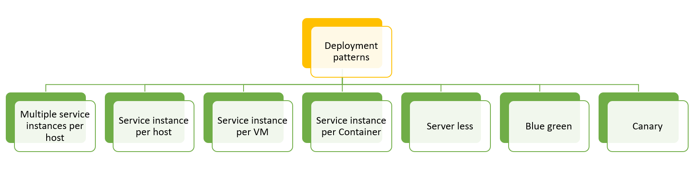

Slide 64
Microservices Architecture
MICROSERVICES DESIGN PATTERNS
Decomposition Pattern : Summary

Slide 67
Microservices Architecture
MICROSERVICES DESIGN PATTERNS
Database Patterns :
DB / Shared-DB per service

Slide 68
Challenges with microservices architecture
Services must be loosely couples so that they can be
Developed independently
Deployed independently
Scaled independently
Unique requirement for each service
Different data
Different storage type

Slide 69
Database Per service

Slide 70
Database Per service
Benefits
Loosely coupled
Free to choose database type e.g. RDBS, mongo Cassandra etc.
if you are using a relational database then the options are:
Private-tables-per-service –
each service owns a set of tables that must only be accessed by that service
Schema-per-service –
each service has a database schema that’s private to that service
Database-server-per-service –
each service has it’s own database server.

Slide 71
Database Per service
Challenges
Queries that needs join over multiple database
Transactions across multiple databases
Solutions
Queries that needs join over multiple database
CQRS
Event Sourcing
API Compositions
Transactions across multiple databases
Saga Pattern

Slide 72
Shared DB per service
Brownfield Projects

Slide 73
Shared DB per service
Brownfield Projects
ORDER table
Id | Cust_id | Status | sum | ..
12345 | 9876 | Complete | 1000
Customer table
Id | name | address | Address_type
9876 | xyz | Noida | home
1111 | abc | Delhi | office

Slide 74
Shared DB per service
Benefits
Familiar
Simpler to operate
Drawbacks
Runtime coupling
Development time coupling
Might not satisfy the storage and access requirement of all services

Slide 75
Microservices Architecture
MICROSERVICES DESIGN PATTERNS
Database Patterns :
CQRS(Command Query Responsibility Segregation)

Slide 76
Problem Statement
Create
Update
Delete
Product Service
View Only
Order Service

Slide 77
The Way out
Product Service
History Service
Order Service
View Only
Create
Update
Delete

Slide 78
CQRS
Create
Update
Delete
Command
Query
Responsibility
Segregation
View Only

Slide 79
MICROSERVICES ARCHITECTURE
Database triggers and procedures
Product Service
History Service
Product Event
Event handlers
Order Service
Create
Update
Delete
Order Event
View Only

Slide 80
CQRS : Challenges
How the data will come to History Service Database?
Events
Database replication methods
Replication delay
Extra complexity
Code Duplication

Slide 81
CQRS : Benefits
Responsibility segregation which is the core principle of microservices/distributed systems
Simpler command and query models
Flexibility to choose database for view
Easy to scale

Slide 82
Microservices Architecture
MICROSERVICES DESIGN PATTERNS
Data Consistency
Eventual
Strong

Slide 83

Data Consistency in Distributes Systems
Eventual Consistency
Strong/Strict Consistency
Node1
Node2
Node3
Node4
Node-n

Slide 84
Eventual Consistency
Node1
Node2
Node3
Node4
Node-n

Slide 85
Strong/Strict Consistency
Node1
Node2
Node3
Node4
Node-n

Slide 86
Eventual vs Strong Consistency
Eventual consistency guarantees low latency with some stale data
Strong consistency guarantees updated/latest data with some higher latency

Slide 87
Microservices Architecture
MICROSERVICES DESIGN PATTERNS
Database Pattern :
Event Driven

Slide 88
Event-Driven System
History Service
Use of Message Brokers
Decoupled architecture
Asynchronous communication
Product Service
Mailing Service
Message Broker
Order Service
Analytics Service
Service -n

Slide 89
Event Notification Event Carried State Transfer https://martinfowler.com/articles/201701-event-driven.html

Slide 90
Microservices Architecture
MICROSERVICES DESIGN PATTERNS
Database Pattern :
Event Sourcing

Slide 91
Event-Sourcing System
Order Service
State is stored as a series of events
Any record is about the state change from previous one
We can always replay events to get the state at any point of time
E.g. Git Commit
Efficient
Asynchronous communication
Storage vs performance
Regular snapshots
orderofevents
Archive
Ask for feedback
Mail to user
Inventory update
Completed
Pending
Initiated

Slide 92
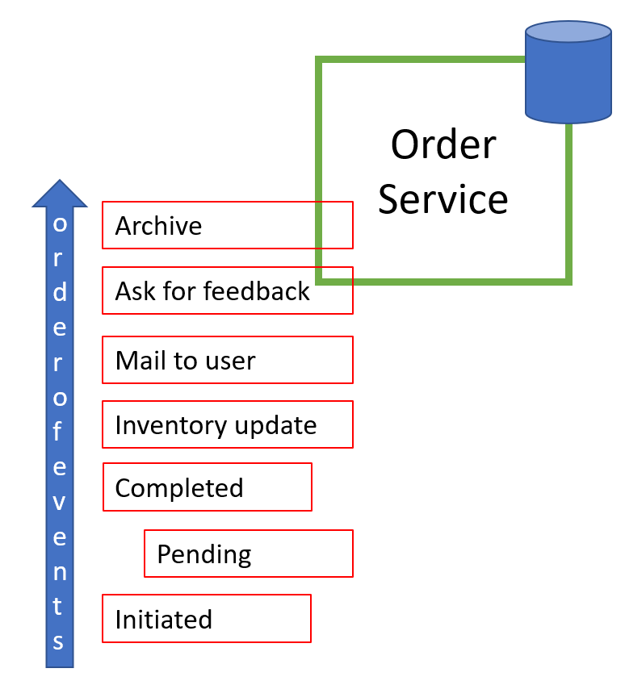
Event-Sourcing System
History Service
Mailing Service
Message Broker
Analytics Service
Service -n

Slide 93
Microservices Architecture
MICROSERVICES DESIGN PATTERNS
How Microservices Communicate with Each Other??

Slide 94
Online Shopping Portal : Monolithic
Product Module
listProduct(productId){
//validateUser() //check For Products
//notifyMerchant(productId)
//return Products }
Payment Module
makePayment(){
//validateUser()
//process the payment
//return response }
Login Module
validateUser(){ //validate user credentials
//return validation status }
Order Module
placeOrder(cartId){
//validateUser() //checkProductAvailability()
//makePayment()
//placeOrder
//notifyUser()
//return response }
Mailing Module
notifyUser() {
//mail/sms to the user about order }

Slide 95
Online Shopping Portal : Microservices
Product Service
listProduct(productId){
//validateUser() //check For Products
//notifyMerchant(productId)
//return Products }
Payment Service
makePayment(){
//validateUser()
//process the payment
//return response }
Login Service
validateUser(){ //validate user credentials
//return validation status }
Order Service
placeOrder(cartId){
//validateUser() //checkProductAvailability()
//makePayment()
//placeOrder
//notifyUser()
//return response }
Mailing Service
notifyUser() {
//mail/sms to the user about order }

Slide 96
Challenges
How to connect 2 services?
How to process the request & response?
Network latency
HTTP
Hyper Text Transfer Protocol
RPC
Remote Procedure Call
Messaging
XML
Extensible Mark-up Language
JSON
Java Script Object Notation
https://github.com/greenlearner01/JSON
Synchronous
Asynchronous

Slide 97
Microservices Architecture
MICROSERVICES DESIGN PATTERNS
Synchronous vs Asynchronous Communication

Slide 98
Synchronous Communication
Product Service
Payment Service
Order Service
Mailing Service
Analytics Service

Slide 99
Asynchronous Communication
Message based
Call-back
Product Service
Payment Service
Order Service
Mailing Service
Message Broker
Analytics Service

Slide 100
Synchronous
Asynchronous
Easy to implement
Easy to test
Easy to debug
Blocking
Slow due to waiting
High coupling
Reliable due to response
Difficult due to message broker
Difficult to test
Difficult to debug
Non-blocking
Fast
Loose coupling
Not Reliable due to no-response

Slide 101
Which one should we use??

Slide 102

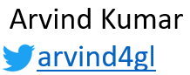
Microservices Architecture
MICROSERVICES DESIGN PATTERNS
How to setup Synchronous Communication among microservices? HTTP

Slide 103
server
client
Request
Response

Slide 104
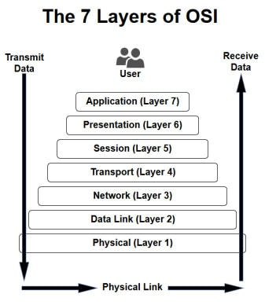
HTTP : Hyper Text Transfer Protocol
Communication protocol that transports messages from one place to other over a network
Stateless
State is maintained using cookies or session
Application layer protocol

Slide 105
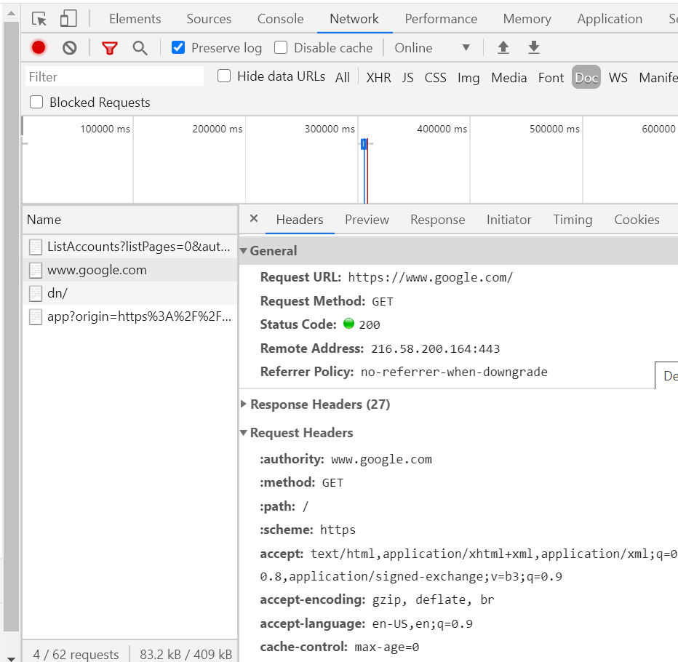
Http Request Format
URL
Method
GET
POST
PUT
Delete etc..
Headers
Body[optional]

Slide 106
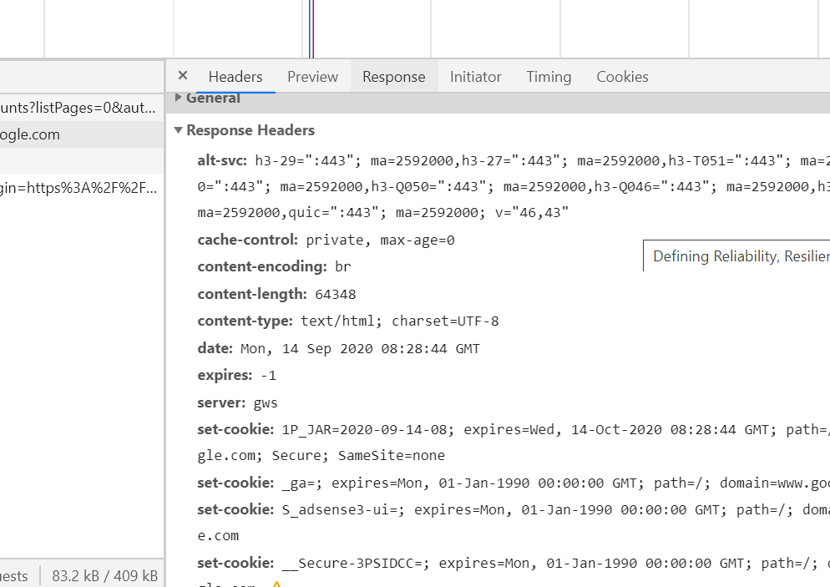
Http Response Format
http status code
Informational responses (100–199),
Successful responses (200–299),
Redirects (300–399),
Client errors (400–499),
and Server errors (500–599).
Headers
Body[optional]

Slide 107
Online Shopping Portal : Microservices
Product Service
listProduct(productId){
//validateUser() //check For Products
//notifyMerchant(productId)
//return Products }
Payment Service
makePayment(){
//validateUser()
//process the payment
//return response }
Login Service
validateUser(){ //validate user credentials
//return validation status }
Order Service
placeOrder(cartId){
//validateUser() //checkProductAvailability()
//makePayment()
//placeOrder
//notifyUser()
//return response }
Mailing Service
notifyUser() {
//mail/sms to the user about order }

Slide 108
REST – Representational State Transfer
RESTfull API
https://youtu.be/is6DMB-nNlE
Microservice with Spring Boot
https://www.youtube.com/playlist?list=PLq3uEqRnr_2Hb9M-hz6GPVg_x9TUQ9PJA

Slide 109
Microservices Architecture
MICROSERVICES DESIGN PATTERNS
How to setup Asynchronous communication :
Message Based

Slide 110
Different approaches for message based communication
Notifications
Request/asynchronous response
Publish/subscribe
Publish/asynchronous response

Slide 111
How to implement the messaging based communication??

Slide 112


Microservice B
Microservice A
Queue 1
Microservice C
Queue 2
Microservice D

Slide 113


Microservice B
Microservice A
Queue 1
Microservice C
Queue 2
Microservice D

Slide 114


Microservice B
Microservice A
Topic 1
Microservice C
Topic 2
Microservice D

Slide 115
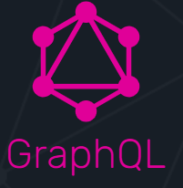
Microservices Architecture
MICROSERVICES DESIGN PATTERNS
What is GraphQL?

Slide 116
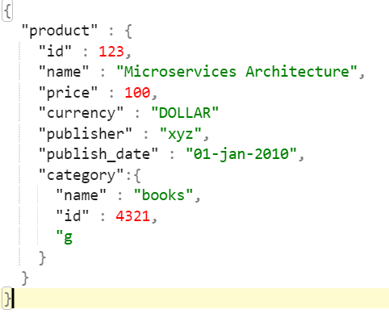
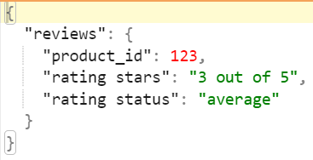
Current Scenario
Product Service
GET /product/{id}
Payment Service
Client Service
GET /product/{id}/reviews
Order Service
UI

Slide 117
Problem with current scenario??
Problem with current scenario??
Overfetching
Underfetching

Slide 118
GraphQL
GraphQL is the better REST
Query language for your API
Strong type system to define the capabilities of the API
An schema serves as contract between client and server

Slide 119
Microservices Architecture
MICROSERVICES DESIGN PATTERNS
Microserivces Communication Patterns
Summary

Slide 120
Summary
How microservices talk to each other?
Synchronous vs Asynchronous communication
How to setup synchronous communication
How to setup Asynchronous communication – Message Bases
REST API
GraphQL

Slide 122
Microservices Architecture
MICROSERVICES DESIGN PATTERNS
Microservices Integration Patterns:
API Gateway

Slide 123
How do the clients of microservices based application access the individual microservice??

Slide 124


Direct Communication
Online Shopping Portal
Product Service
Aggregating data from multiple services
Too much chatty behaviour between clients and services
Non-web friendly protocol -> AMQP
How to handle the change in location(host + port) of services
Cross cutting concerns like
Security (Authentication & Authorization)
Logging, tracing
Load balancing
Caching
IP whitelisting
Request/response transformations
Failure handling – circuit breaker
Addressing the needs of different clients like desktop, mobile or any other service
High coupling for each client
Payment Service
Order Service
3rd party service
Inventory Service

Slide 125
API GATEWAY
Online Shopping Portal
Product Service
S
I
N
G
L
E
E
N
T
R
Y
P
O
I
N
T
Payment Service
Order Service
3rd party service
Inventory Service

Slide 126
API GATEWAY(Backend for frontend-BFF)
Online Shopping Portal
Product Service
Single entry point
Payment Service
Single entry point
Order Service
Single entry point
3rd party service
Inventory Service

Slide 127
API Gateway
Aggregating data from multiple services
Reduces the request roundtrips
Non-web friendly protocol
Client is able to use single standard protocol to communicate to API gateway and independent of what protocol is used in specific service
How to handle the change in location(host + port) of services
Not the headache of client
Cross cutting concerns like (All of these are now responsibility of API gateway, centralized/clean/standard code)
Security(Authentication & Authorization)
Logging, tracing
Load balancing
Caching
IP whitelisting
Request/response transformations
Failure handling – circuit breaker
Addressing the needs of different clients like desktop, mobile or any other service
High coupling for each client
Now each client has it’s own optimal API gateway

Slide 128
Few Drawbacks
Extra application
Increased complexity of overall application
Increased latency

Slide 129
Implementations
Write your own API gateway
Netflix Zuul - https://www.youtube.com/playlist?list=PLq3uEqRnr_2GleAdJYmlBkB_RfbjMGdoH
Spring cloud gateway – Coming Soon
3rd Party providers
Kong - https://konghq.com/kong
Apigee – https://cloud.google.com/apigee
Amazon API Gateway - https://aws.amazon.com/api-gateway

Slide 130
Microservices Architecture
MICROSERVICES DESIGN PATTERNS
Microservices Observability Patterns:
Performance Metrics & Health Check

Slide 131

Docker

Slide 132
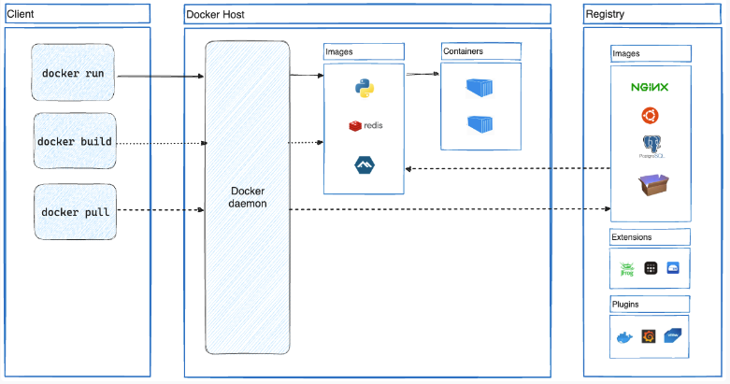
Docker Architecture

Slide 133
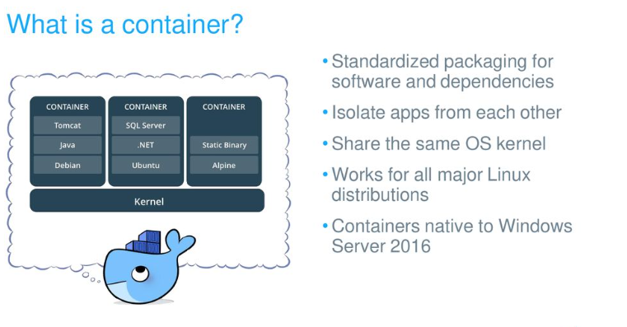
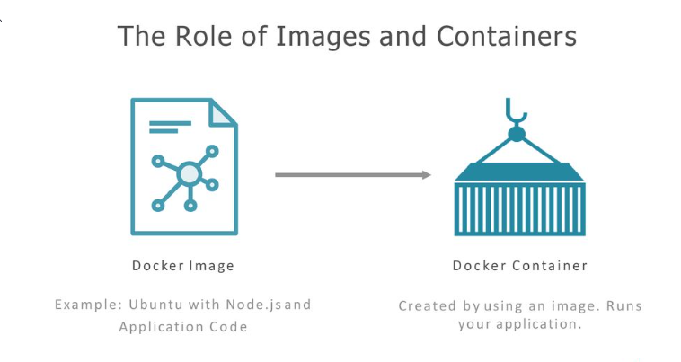

Slide 134
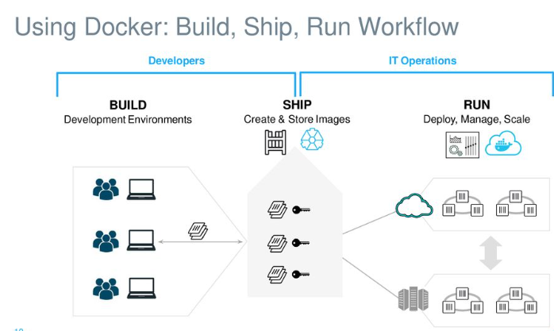
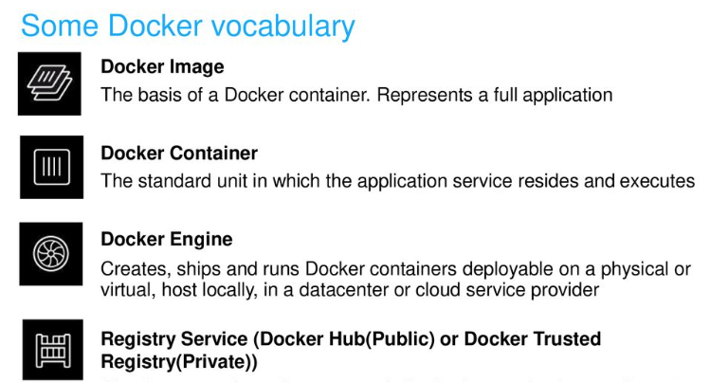

Slide 135
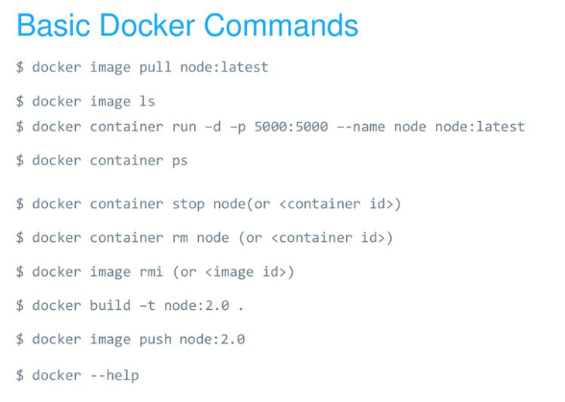
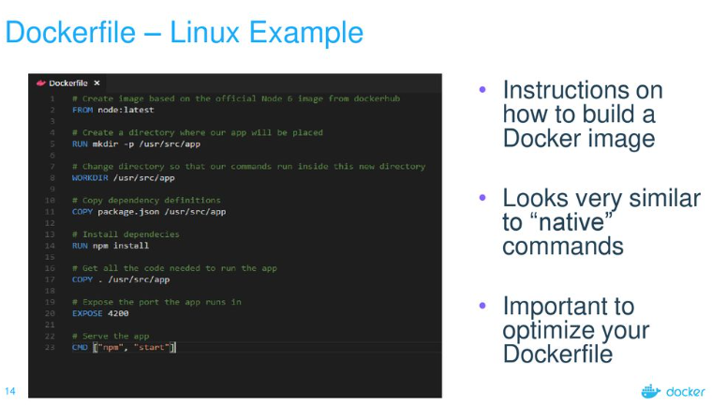
Docker – Linux example

